Slide 1
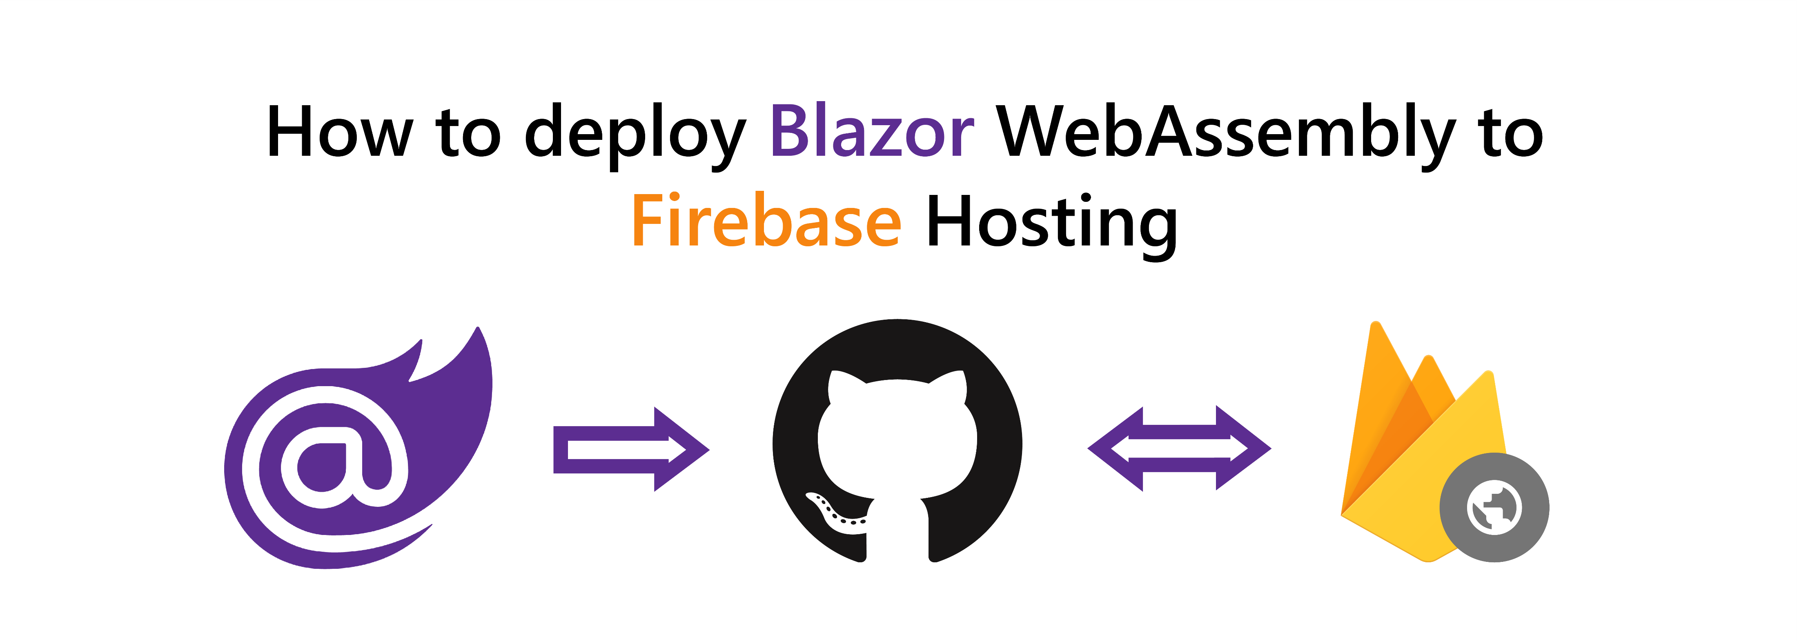

© Niels Swimberghe
https://swimburger.net - @RealSwimburger

Slide 2

About me
Niels Swimberghe aka Swimburger
.NET Web Developer
Blog at swimbuger.net
Twitter: @RealSwimburger

Slide 3

What is Firebase Hosting?
Static site hosting service (HTML, CSS, JavaScript, etc.)
Support custom domains
Part of Firebase suite of products and services
Spark plan is free but limiting (only 360 MB/day data transfer 😿) For perspective, swimburger.net served 956 MB to serve 691 unique users Today (1/17/2021 according to Cloudflare stats)

Slide 4

Alternatives?
Azure Static Web Apps (Blazor WASM Walkthrough)
GitHub Pages (Blazor WASM Walkthrough)
Netlify
Vercel
Cloudflare in front of Firebase Hosting
Many more

Slide 5
What are we going to do?
Create a Blazor WASM project
Create a GitHub repository (optional)
Deploy to Firebase Hosting from the CLI
Automatically deploy to Firebase Hosting using GitHub Actions (optional)

Slide 6

SUCCESS!?

Slide 7


More .NET, Web, Azure, etc.
@RealSwimburger
https://swimburger.net

